Slide 1
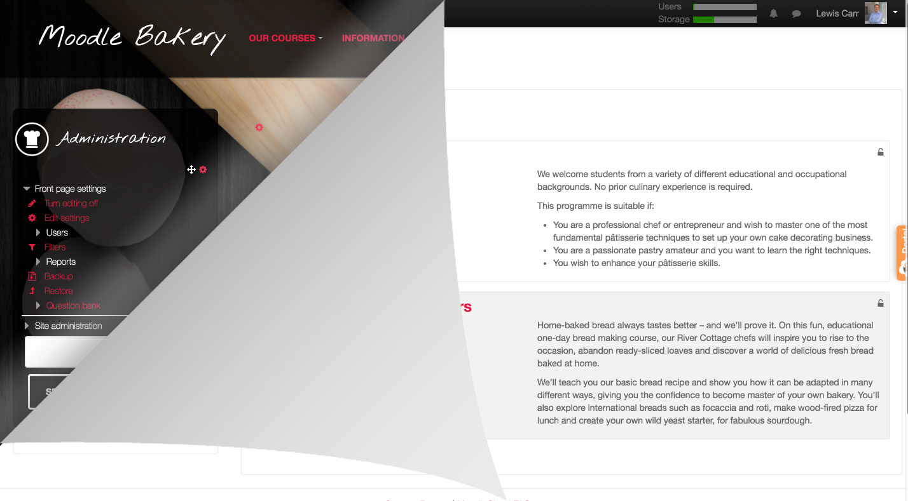
Transform your MoodleCloud site theme and make it look incredible with just a stylesheet
Lewis Carr @lewiscarr #MootIEUK19
of 20

Slide 2
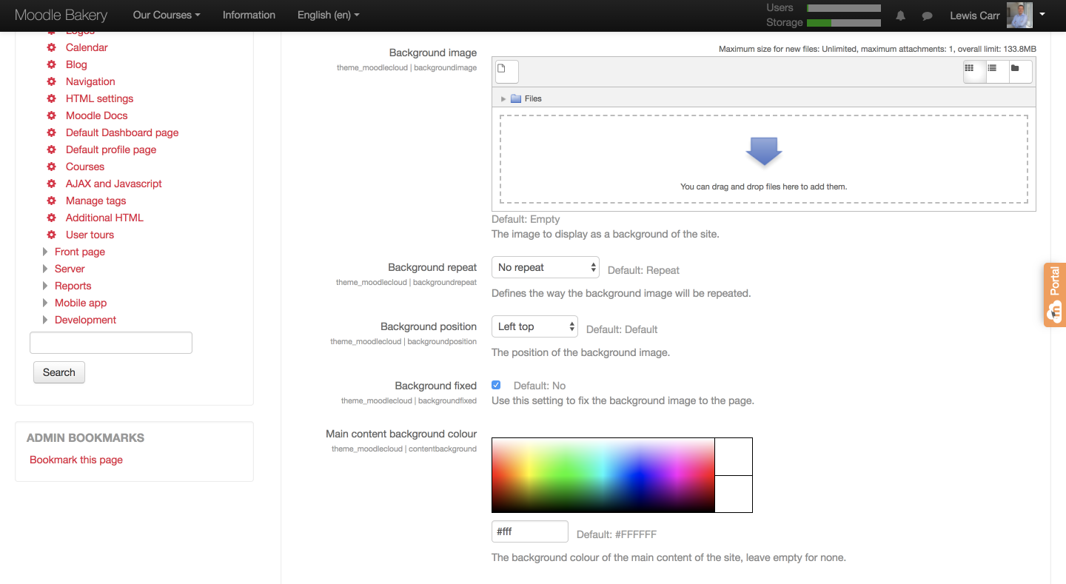
Moodle Cloud Theme Settings
of 20

Slide 3
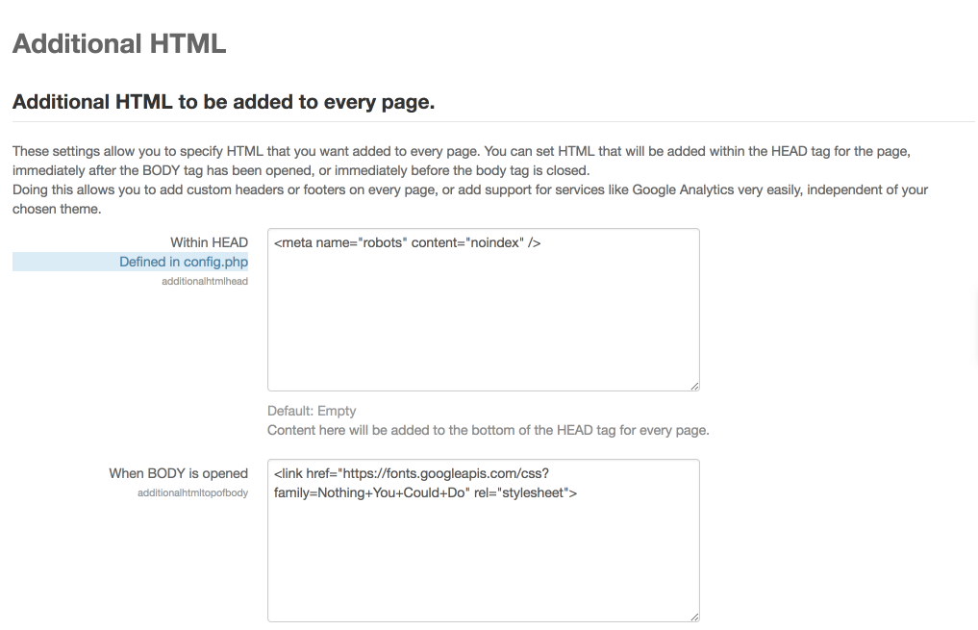
How to add google fonts and other widgets
Site Administration > Appearance > Additional HTML
of 20

Slide 4
Moodle Header
#nav-moodlecloud-quota-popover-container progress {
border:2px solid #fff
width: 100px;
height: 10px;
}
Add Google font via Appearance > Additional HTML
i.icon.fa.fa-bell {
background: green;
padding: 10px;
border: 2px solid #fff;
border-radius: 150%;
color: #fff;
}
background: rgba(0,0,0,.8);
of 20

Slide 5
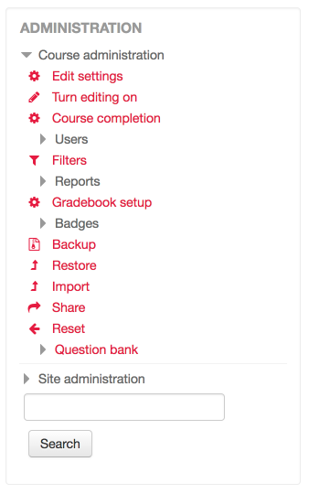
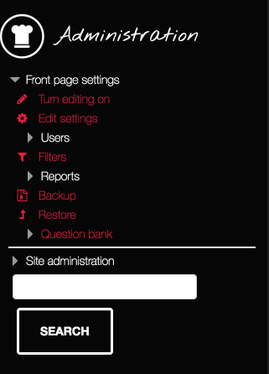
Blocks
.block .header h2 {
background: url(path-to-img);
background-size: contain;
background-repeat: no-repeat;
padding: 20px 10px 20px 70px;
}
.block .header h2 {
font-size: 24px;
font-family: 'Nothing You Could Do';
}
.block {
background: rgba(0,0,0,.8);
}
of 20

Slide 6
Footer
p.helplink a {
background: green;
color: #fff;
padding: 7px 15px 7px 15px;
border: 2px solid #fff;
border-radius: 7px;
}
#page-footer {
background-color: transparent!important;
background: url(path-to-url);
background-size: cover;
}
of 20

Slide 7
Available Courses
div#frontpage-available-course-list h2 {
text-transform: uppercase;
font-size: 500%;
color: #edb680;
text-align: center;
line-height: 90px;
}
.coursebox .enrolmenticons {
float: right;
background: green;
padding: 10px;
border-radius: 150%;
border: 3px solid #fff;
}
.coursebox .content .courseimage img {
max-width: 300px;
max-height: 300px;
border-radius: 30px;
border: 3px solid #fff;
}
of 20

Slide 8
Final Frontpage
of 20

Slide 9
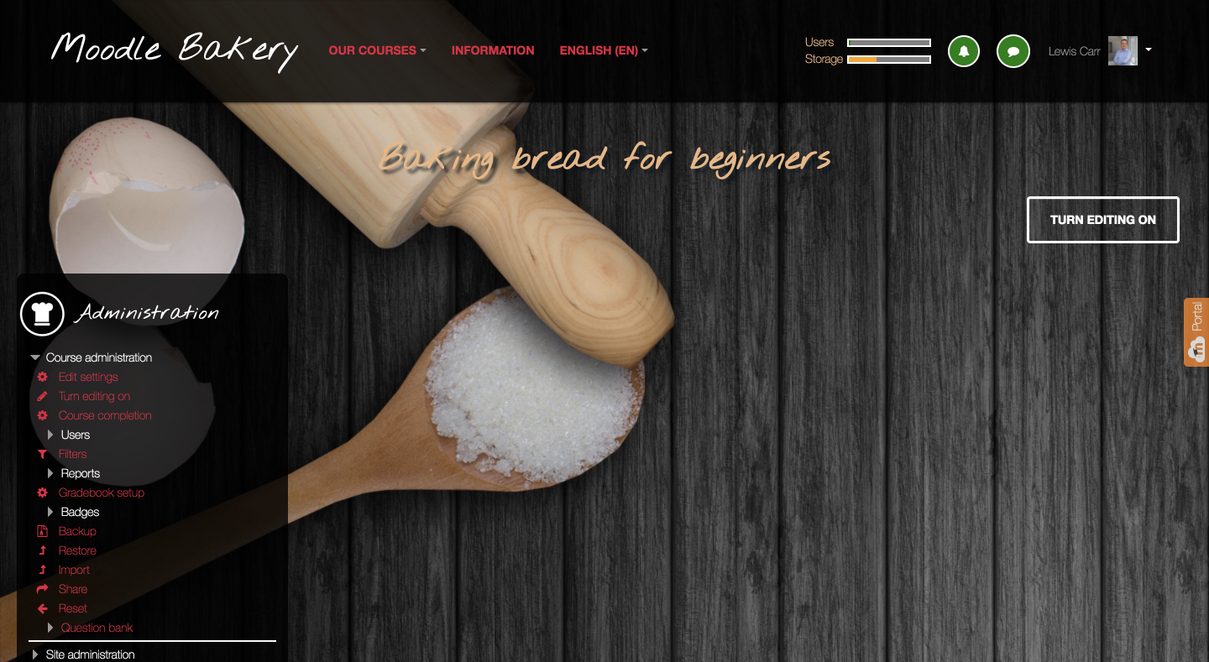
Courses page no elements
of 20

Slide 10
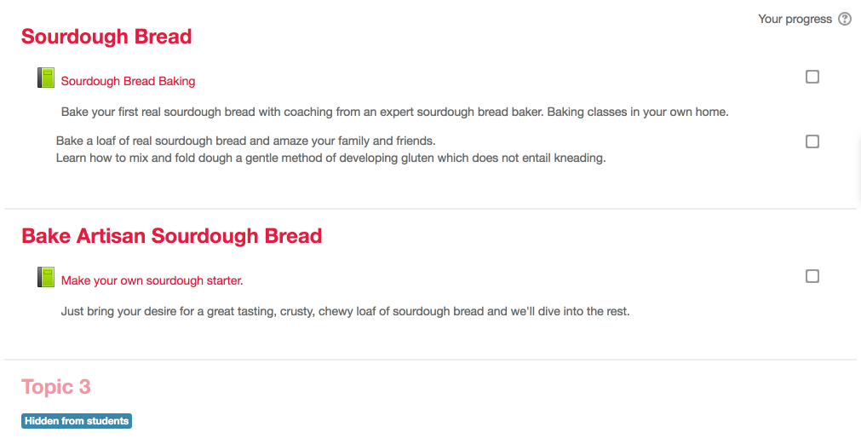
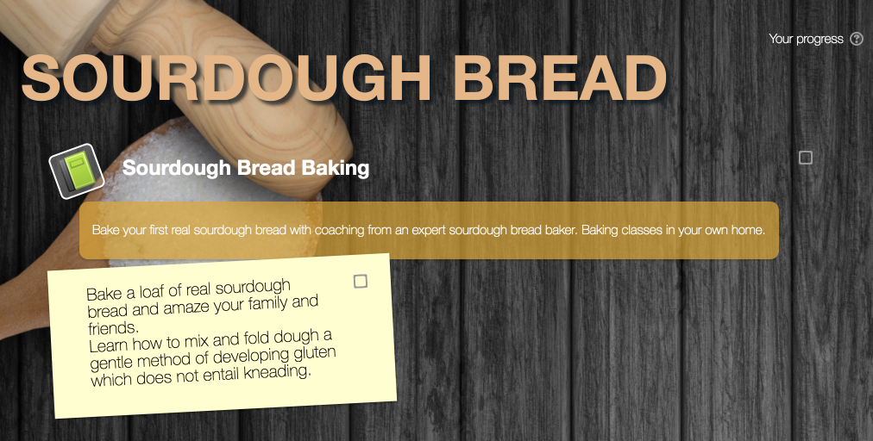
Course Page elements
h3.sectionname a {
text-transform: uppercase;
font-size: 300%;
color: #edb680;
max-width: 500px;
line-height: 90px;
}
li.activity.label, .file-picker td.label {
color: #000;
border: inherit;
text-shadow: none;
display: block;
background: #ffc;
border-radius: 0;
padding: 20px 20px 20px 20px!important;
font-size: 130%;
transform: rotate(-3deg);
max-width: 40%;
}
of 20

Slide 11
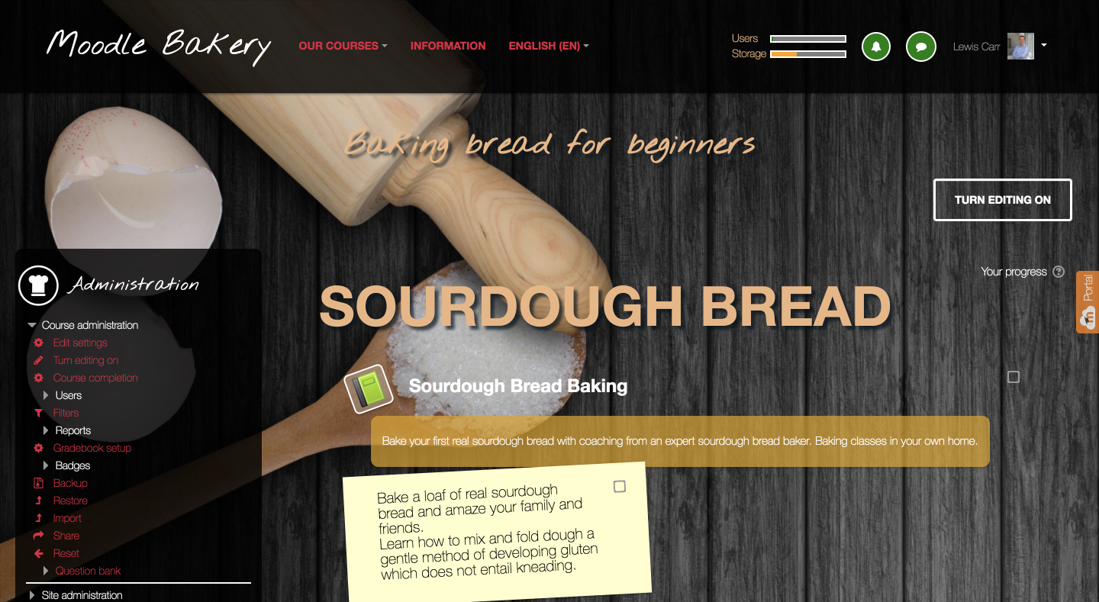
Course Page completed
of 20

Slide 12
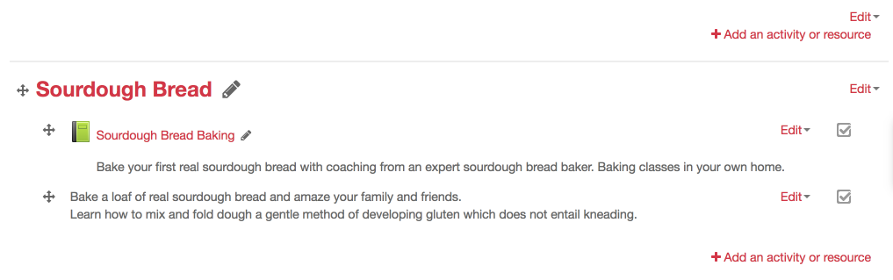
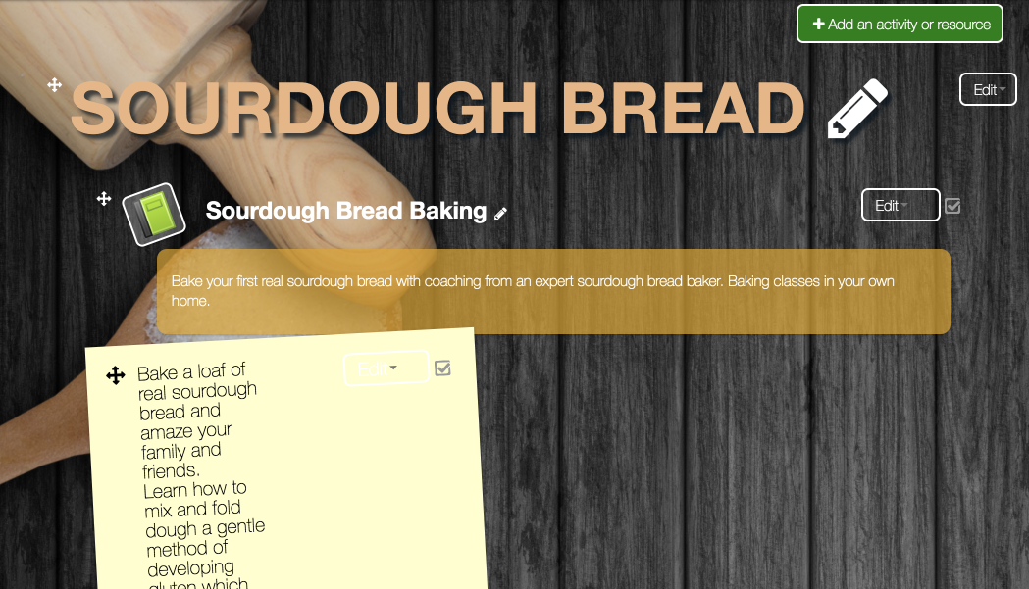
"Course Editing" elements
of 20

Slide 13
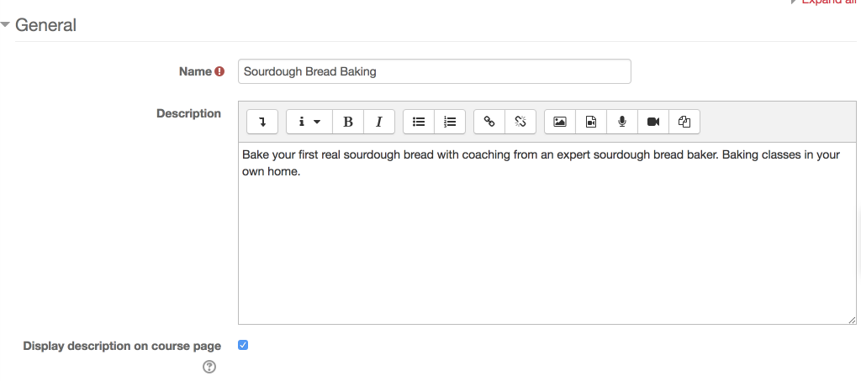
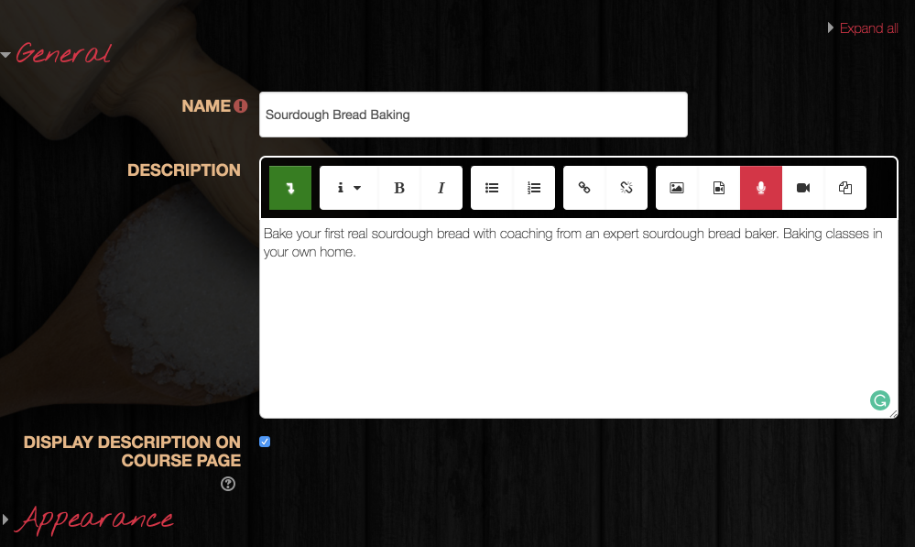
Moodle forms
button.atto_collapse_button {
background: green!important;
}
i.icon.fa.fa-level-down.fa-fw {
color: #fff;
font-weight: 700;
}
div.editor_atto_toolbar {
background: rgba(0,0,0,.8);
min-height: 35px;
border: 2px solid #fff;
border-top-left-radius: 7px;
border-top-right-radius: 7px;
}
of 20

Slide 14
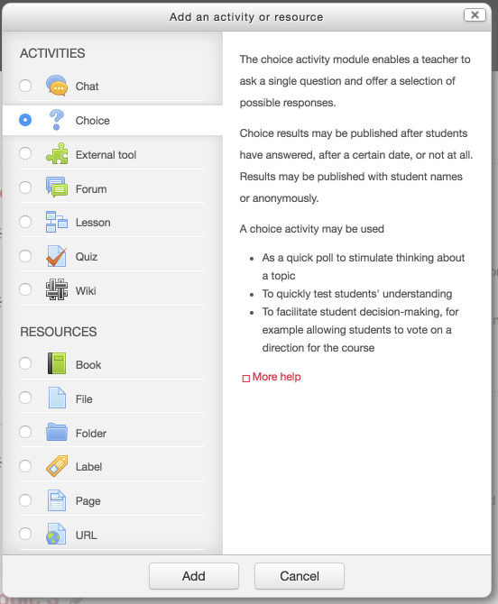
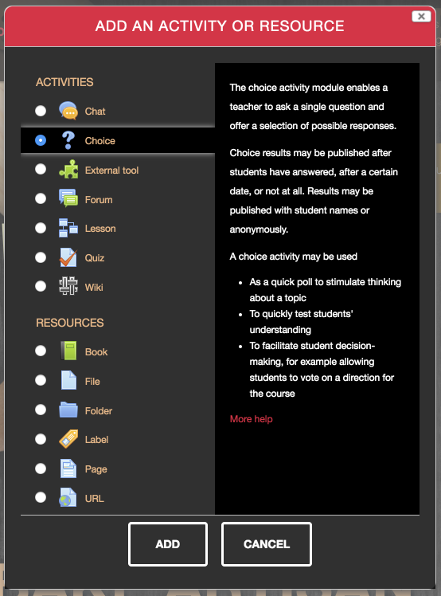
Activity Selector
.moodle-dialogue-base .moodle-dialogue-wrap .moodle-dialogue-hd, .moodle-dialogue-base .moodle-dialogue-wrap .moodle-dialogue-hd.yui3-widget-hd {
background: #e51c41;
color: #fff;
text-shadow: none;
text-transform: uppercase;
font-size: 130%;
padding: 15px 10px 15px 10px;
}
.jschooser .choosercontainer #chooseform .typesummary {
background: #000;
color: #fff;
}
of 20

Slide 15
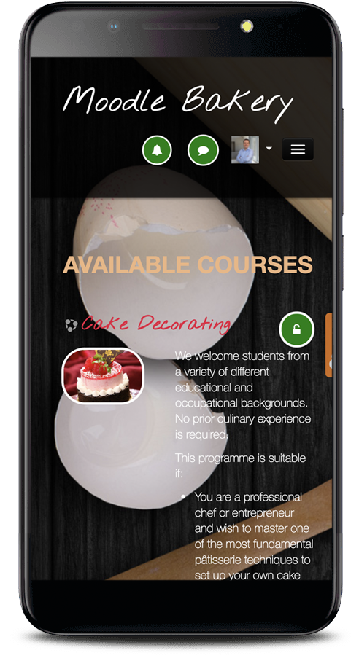
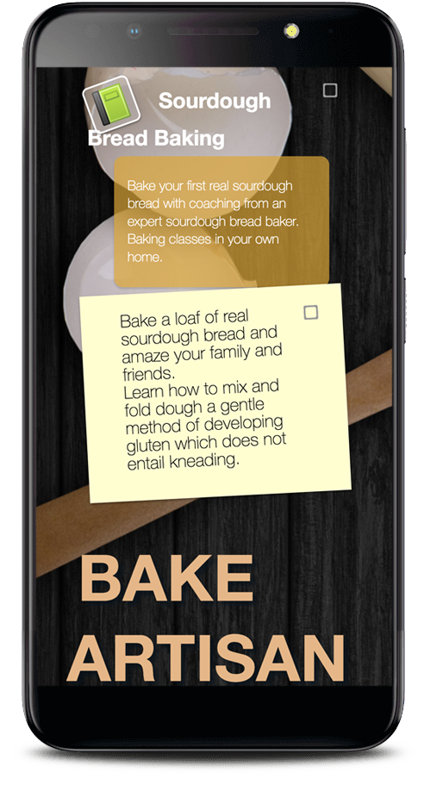
On Mobile
of 20

Slide 16
How to get started
Pick your favourite Moodle theme (any theme, not just Moodlecloud)
Use Inspect tools in all good browsers (Right click, then Inspect)
Edit live using these tools – type new CSS over the old – non-destructive
Need to learn CSS?
https://www.codecademy.com/learn/learn-css
https://www.w3schools.com/css/
of 20

Slide 17
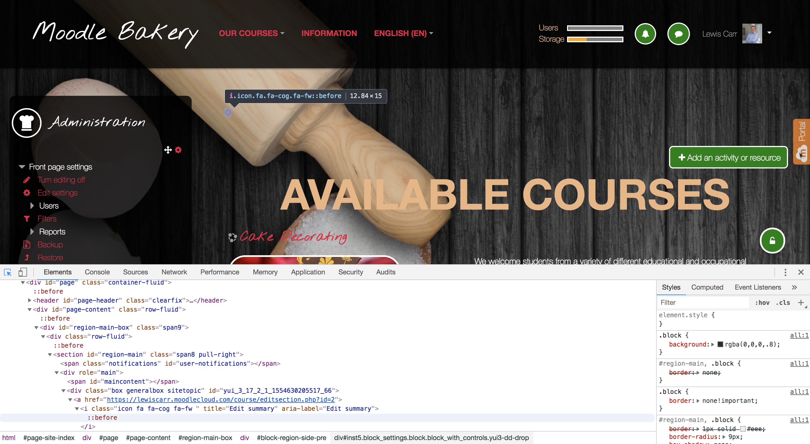
The inspect tool, a quick tour
of 20

Slide 18
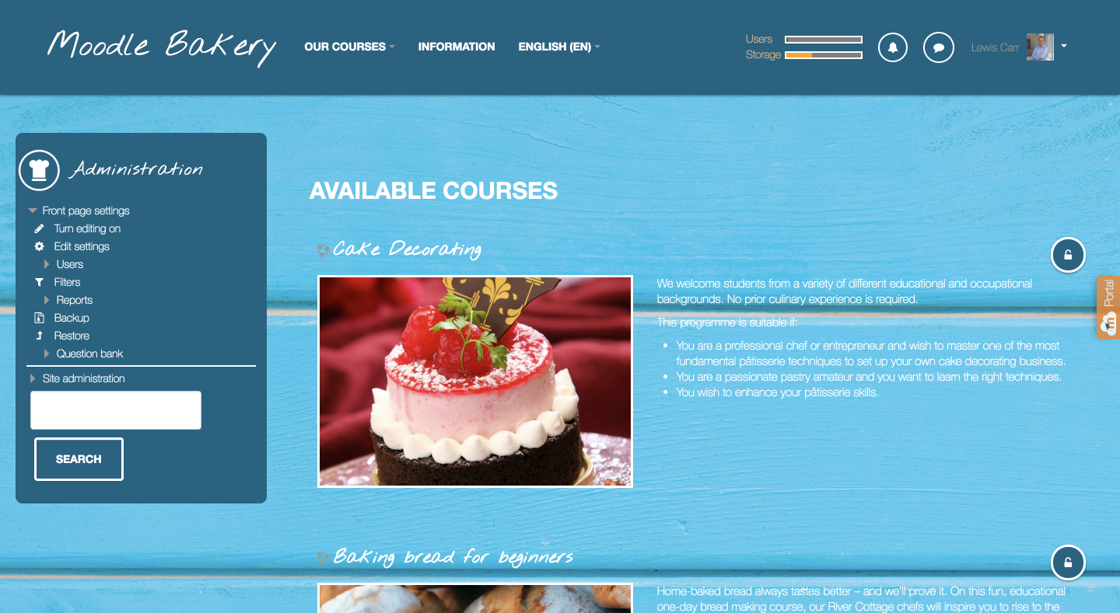
Variation of the theme
of 20

Slide 19
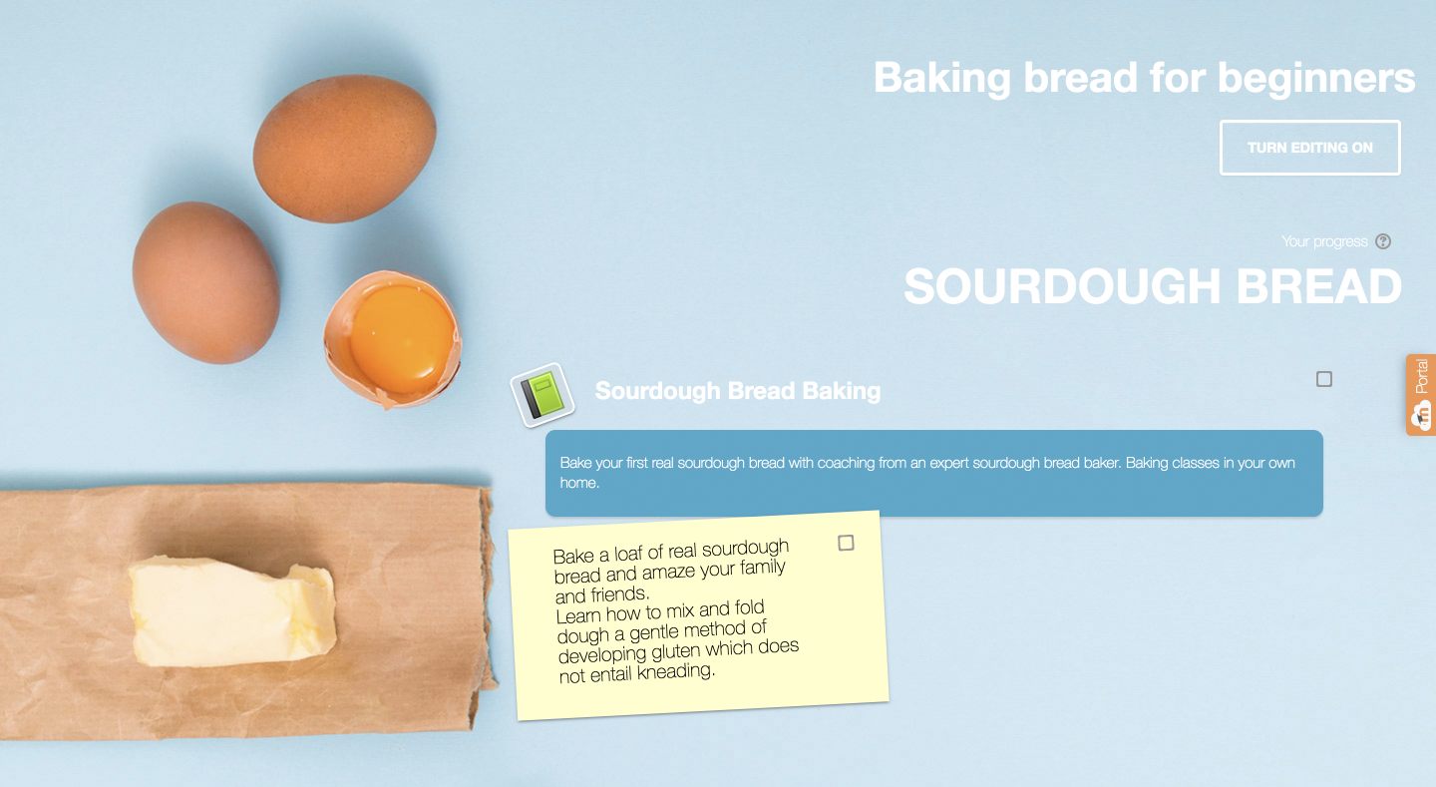
Simplification of the theme
of 20

Slide 20
Summary and Conclusions
MoodleCloud can look every bit as amazing as any other Moodle theme.
Next Steps
Moodle Bakery
https://github.com/lewiscarr/moodlebakery
Share your creations via social media and forums
Come present at the next Moot?
“Have no fear of perfection—you’ll never reach it.” –Salvador Dali
of 20

